Slide 1



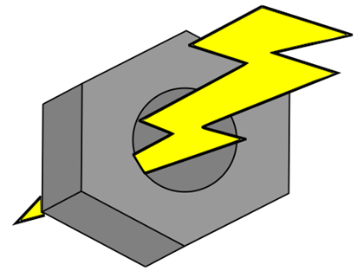


Live Bolt Smart Lock and Security System
Linda Anyosa (EE)
Mohamed Faizel (CPE)
Andrew O'Reilly (EE)
Joel Shaw (CPE)
Group 22 (F)
Notes:
Joel

Slide 2




Meet the Team
Linda Anyosa
Mohamed Faizel
Andrew O’Reilly​
Joel Shaw​
Electrical Engineer
Computer Engineer
Electrical Engineer
Computer Engineer

Slide 3

Motivation
The main motivation for creating this project was from our individual experience in package theft. An instance that a package has been labeled delivered but, not within the front door or close radius of a home can be bothersome to a customer.
Notes:
Joel

Slide 4

Objectives
Our main objective for the project is to design innovative security and integrated lock system that combines the features of available systems in the market into a package. To have our project stand out, we plan to offer the most features in access control and home monitoring for the best price while ensuring optimal quality, functionality, and aesthetics to our customer's homes and styles.
Notes:
Mohamed

Slide 5
Requirement Specifications Security System
SECTION | REQUIREMENT | SOLUTION | VERIFICATION
Security System (SS)
SS.1 | Notifying motion sense to consume | Activate PIR sensor every 3 seconds to monitor motion | Integrate sensors to application
SS.2 | Home monitoring | 5 Megapixel, 2592 x 1944 image resolution, 1080p video resolution | Viewable video stream sent from camera
SS.3 | Time stamps unlock attempts from companion app | Send time stamp of unlock time to database with a delay < 2s | Check user’s text messages
SS.4 | Alarm system | LEDs which trigger once when a correct PIN is given and twice when an incorrect PIN is given | Integrate LEDs into the lock box
Notes:
Mohamed

Slide 6

Requirement Specifications Access Control
SECTION | REQUIREMENT | SOLUTION | VERIFICATION
Access Control (AC)
AC.1 | Allow consumer to access application in more than 1 way | Android/iOS/web application | Publish to App Store/Google Play Store
AC.2 | Allow door to be locked/unlocked in 3+ methods | Unlock/lock remotely via mobile application with touch ID authentication Primary PIN code via keypad Guest PIN code via keypad Door locks 10 seconds after unlocking | Notification sent when door is locked/unlocked LED blinks once for correct PIN and twice for incorrect PIN Guest PIN will only work once before being invalidated
Notes:
The requirement specifications for the access control elements can be seen here. It is made up of 2 main requirements. The first is to allow the consumer to access the application in more than one way, which is important because different people may use different phones and we don’t want that to be a barrier to use Live Bolt. This will be verified by publishing the app to different app stores. The second requirement is to allow the door to be locked/unlocked in 3+ methods. The first method we have is remotely via the phone app which will send a notification to the user’s phone number. The second option is using a primary pin configured by the user. The third option is using a one-time guest code also configured by the user. These both will have the LED blink once for a correct code and twice for an incorrect code. Finally as an added way to lock the door in addition to the app, it will automatically lock 10 seconds after being unlocked. All of this functionality is shown off in the demonstration video.

Slide 7
Requirement Specifications Application
SECTION | REQUIREMENT | SOLUTION | VERIFICATION
Application (A)
A.1 | Simple and user-friendly UI/design | Design application off of a Figma Template and hold to the design standards outlined by the Google and Apple App Stores. | Use a variety of methods to test code, including end-to-end tests using Jest and Puppeteer.
A.2 | Live Bolt must be always-online to mobile application | Using a MERN stack with a React Native Frontend, API served over a Heroku hosted Node.js server with a MongoDB Backend. Request will always be server due to the API living on the cloud. | Display message to user if connection is lost
A.3 | Accessibility | Lock/Unlock Button, TouchID for Lock/Unlocking, Activity Log for any lock/unlock attempts, Camera Monitoring when motion is detected from PIR sensor. | Integrate all 4 methods of access and verify through end-to-end testing using Jest and Puppeteer.
Notes:
Joel – should be good

Slide 8

Requirement Specifications Design Feature
SECTION | REQUIREMENT | SOLUTION | VERIFICATION
Design (D)
D.1 | Locking/ Unlocking Door System | Selected a high torque servo to turn lock, 10 kg*cm with about 170 degrees range of motion. 3D Printed cover for deadbolt turn knob | Servo is successfully able to turn the knob cover enough to lock/unlock door every time
D.2 | Harness electronic parts in casing | Selected PETG as the case for Live Bolt | Compared filaments in the current market: PLA, ABS, PETG
D.3 | Rechargeable Batteries | Designed a box that has a reliable battery system to change AA batteries and/or recharge a battery pack | Understand power requirements for electronic parts
Notes:
Linda [Rough draft recording, not done yet]
Our design feature requirement specifications came down to three of our required choices. We wanted to make sure that our project had a locking door system. We're making sure that will end up being the case with the choice of a servo motor to turn a dead bolt knob. Our second requirement was to harness electronics in a casing. We want to make sure our casing (also known as security or lock box) would be durable to withstand weather and be cheap to manufacture. Lastly, we wanted to make sure that our security and lock boxes had rechargeable batteries. To achieve this goal these boxes would need to be accessible to a user and provide ease when changing AA batteries.

Slide 9
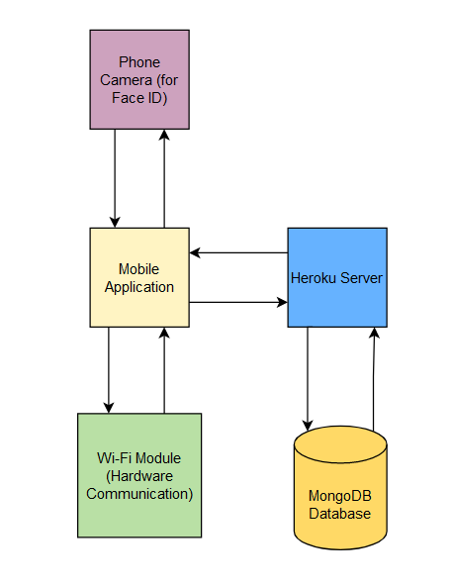
Software Block Diagram
Notes:
Mohamed

Slide 10
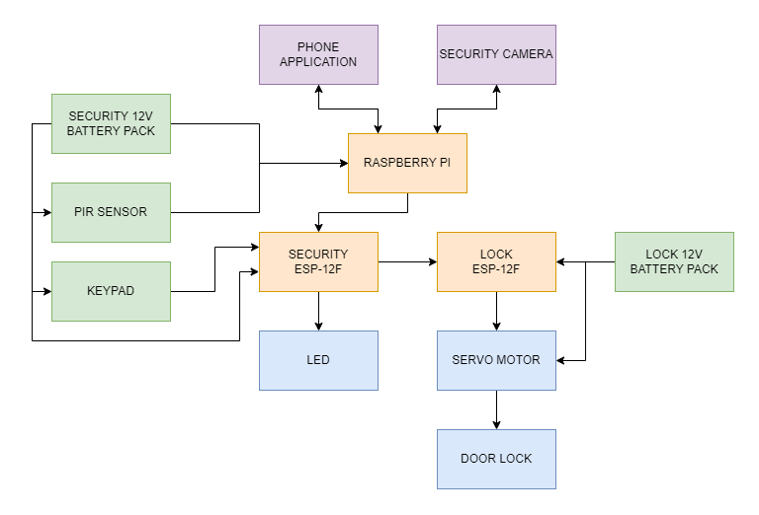
Hardware Block Diagram
Notes:
Here is the Hardware Block Diagram for our project. The camera and PIR sensor are connected to the raspberry pi, while the keypad and LED are connected to the outside security ESP chip. The servo is the only thing connected to the inside ESP-12F chip. The Raspberry Pi will interface with the ESP chips to allow for communication between the outside security module and the indoor locking module. Each module will be powered by their own 12V battery packs. In this block diagram, you can see the outside security module components in the red box and the indoor lock module components in the blue box.

Slide 11
Software Implementation

Slide 12

Frontend Architecture (React Native)
React Native is a cross platform JavaScript UI library currently maintained by Facebook.
We decided to use React Native as the foundation of our frontend due to its portable nature and its superior performance to other UI frameworks such as Flutter and Xamarin.
Additionally, React Native has a variety of developer tools and modules for every aspect of mobile development and testing.
Notes:
Dry run (will probably rerecord)

Slide 13



Backend Architecture (Node.js, Express, and MongoDB)
The Backend Components of the MERN stack consisting of Node and Express JS are previous technologies we have used in previous coursework.
Node is a very popular JavaScript backend runtime environment ensuring widely available documentation. Additionally, both Express and Node are fast frameworks ensuring good response times when communicating across the application.
MongoDB is a fast and scalable database which makes it another ideal choice for our use case within our smart lock.
Notes:
Joel – can stay the same

Slide 14

Remote Backend
Heroku is a cloud platform commonly used to host web applications using languages such as Ruby, Node.js, and Java.
Using Heroku’s hosting capabilities, the Live Bolt backend repository can be accessed remotely by the companion app, preventing the use of a dedicated server and reducing maintenance.
Notes:
Dry run (will probably rerecord)

Slide 15
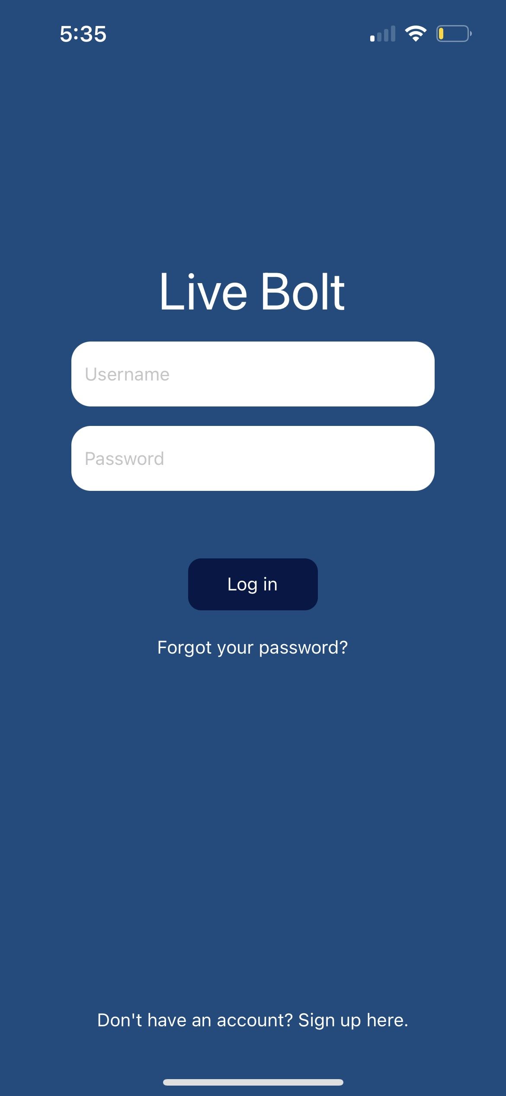
User Authentication
User information is fetched from the remote database to the frontend, including their name, email, phone number, and a unique ID.
Passwords are hashed server-side to prevent leaking of user information and user sessions are authenticated using the JSON Web Token standard.

Slide 16
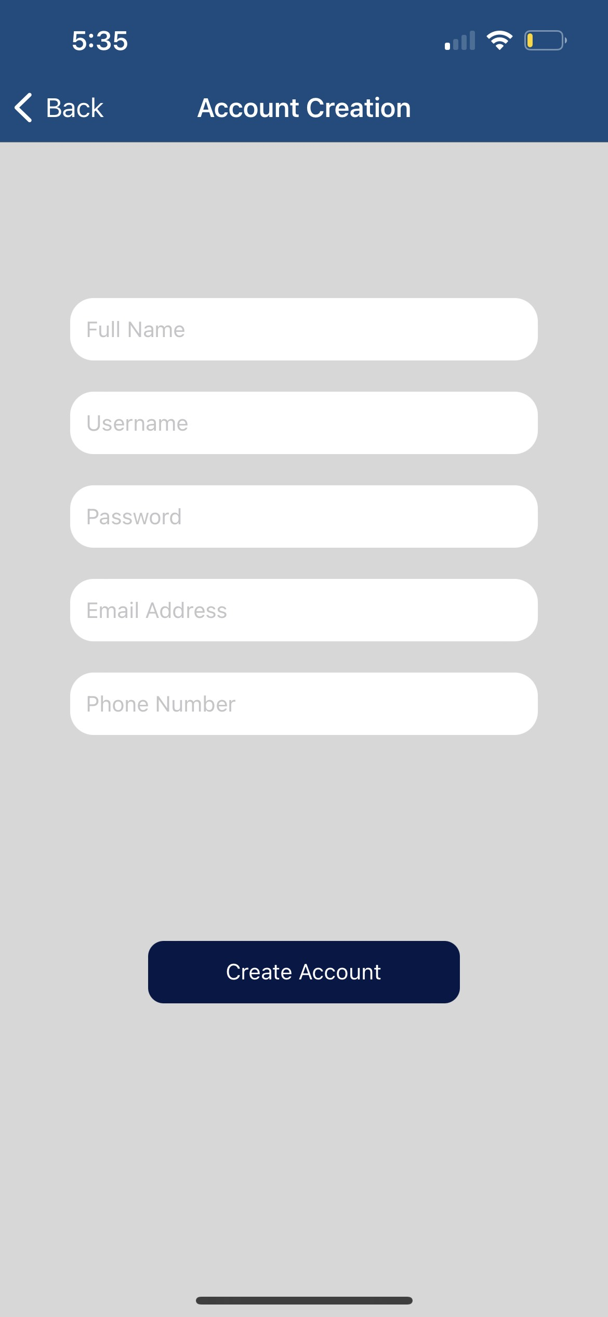
Account Creation
Users must enter a valid username and password, along with their name, email address, and phone number.
User is sent a confirmation email upon account creation and redirected to a page where the user must enter in a 6-digit code to proceed.

Slide 17
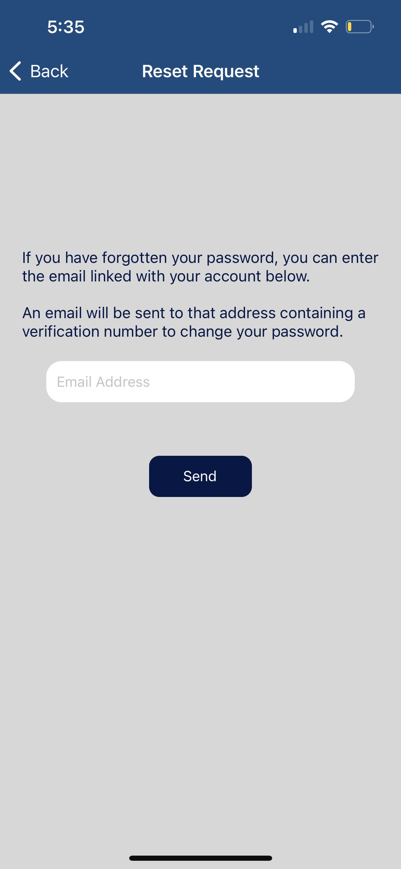
Account Recovery
In the case of a forgotten password, the user can send an email which contains a 6-digit PIN to reset the password.
The app uses the SendGrid API to handle email functionality, allowing fast and secure email handling.

Slide 18
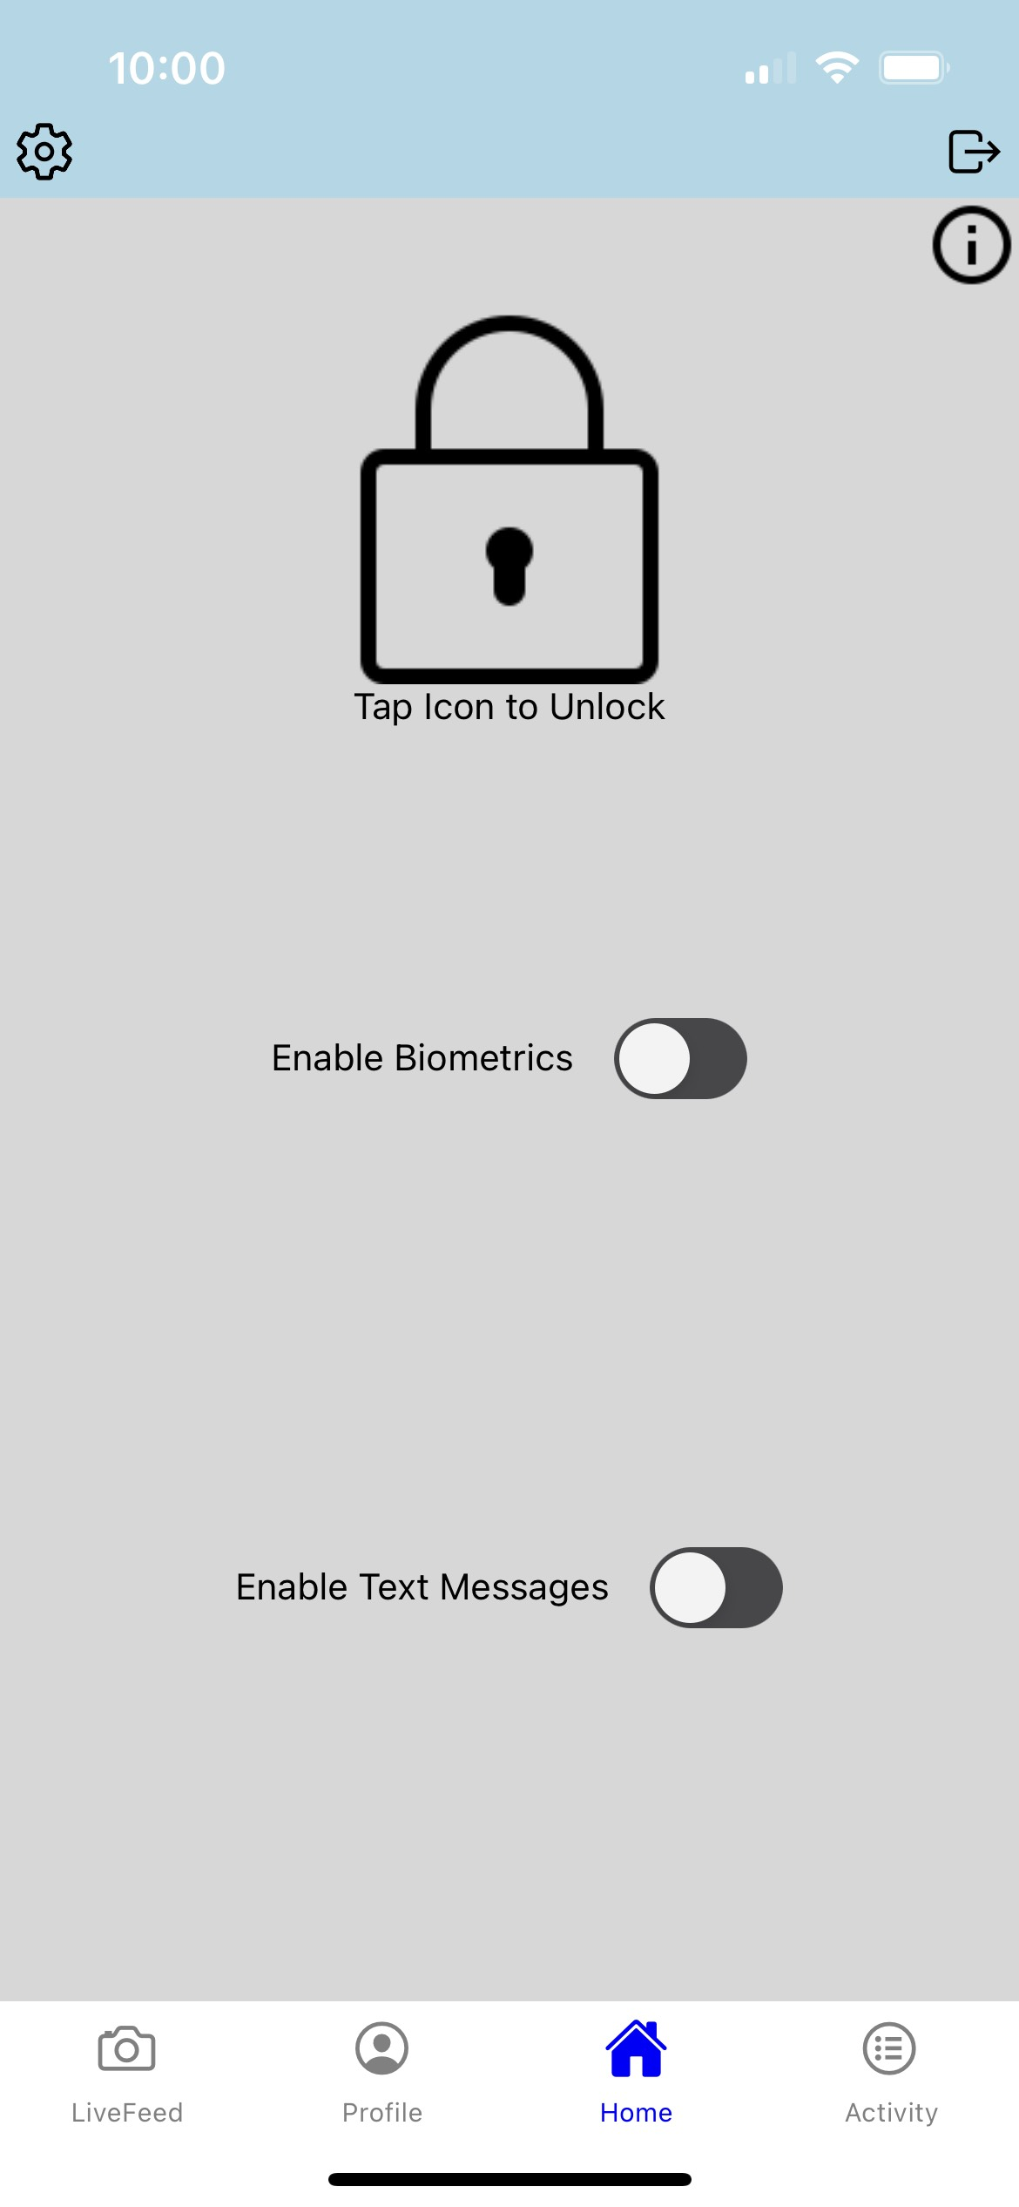
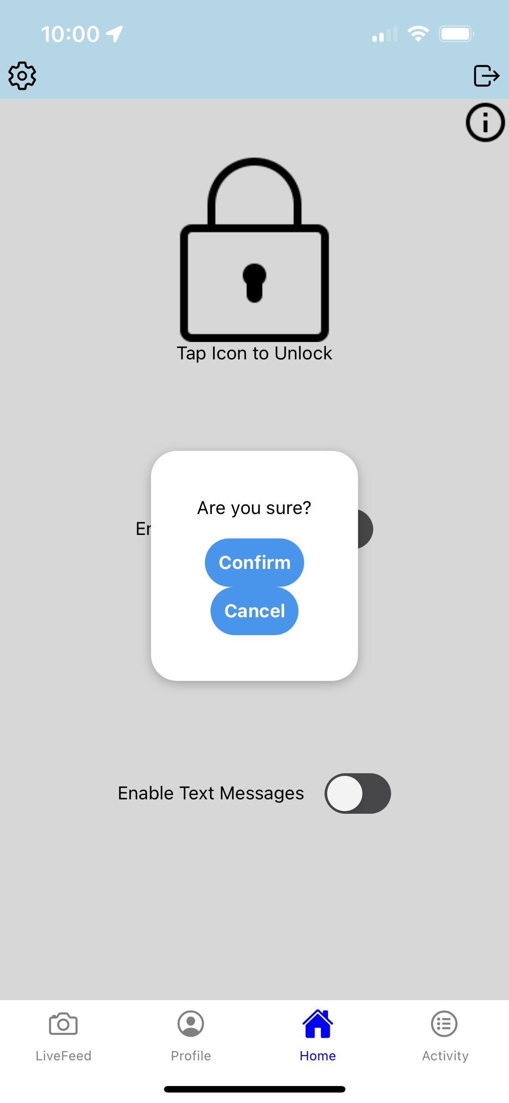
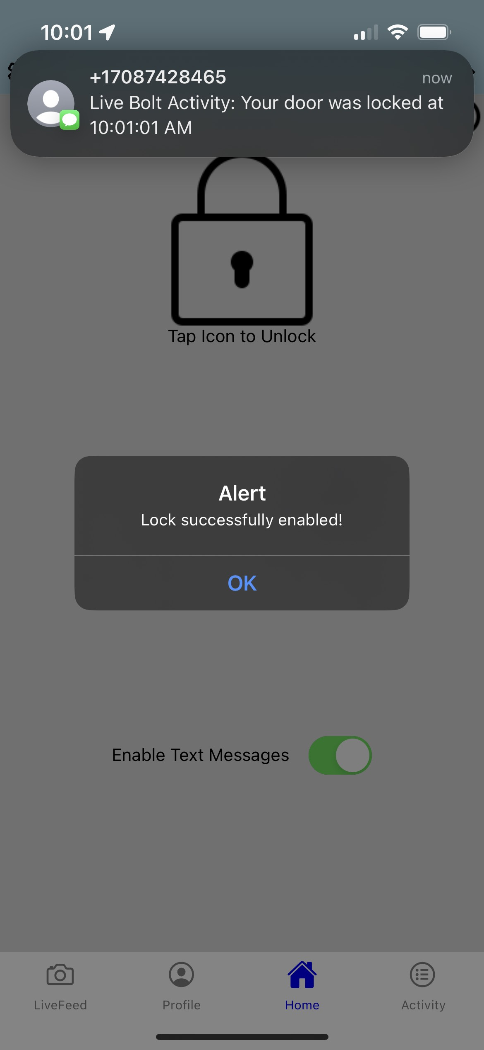
Home Screen
Locked (Default Settings)
Confirmation prompt to change lock.
Locked (w/ Text Alert)
Notes:
Joel – remove location/gps screen

Slide 19
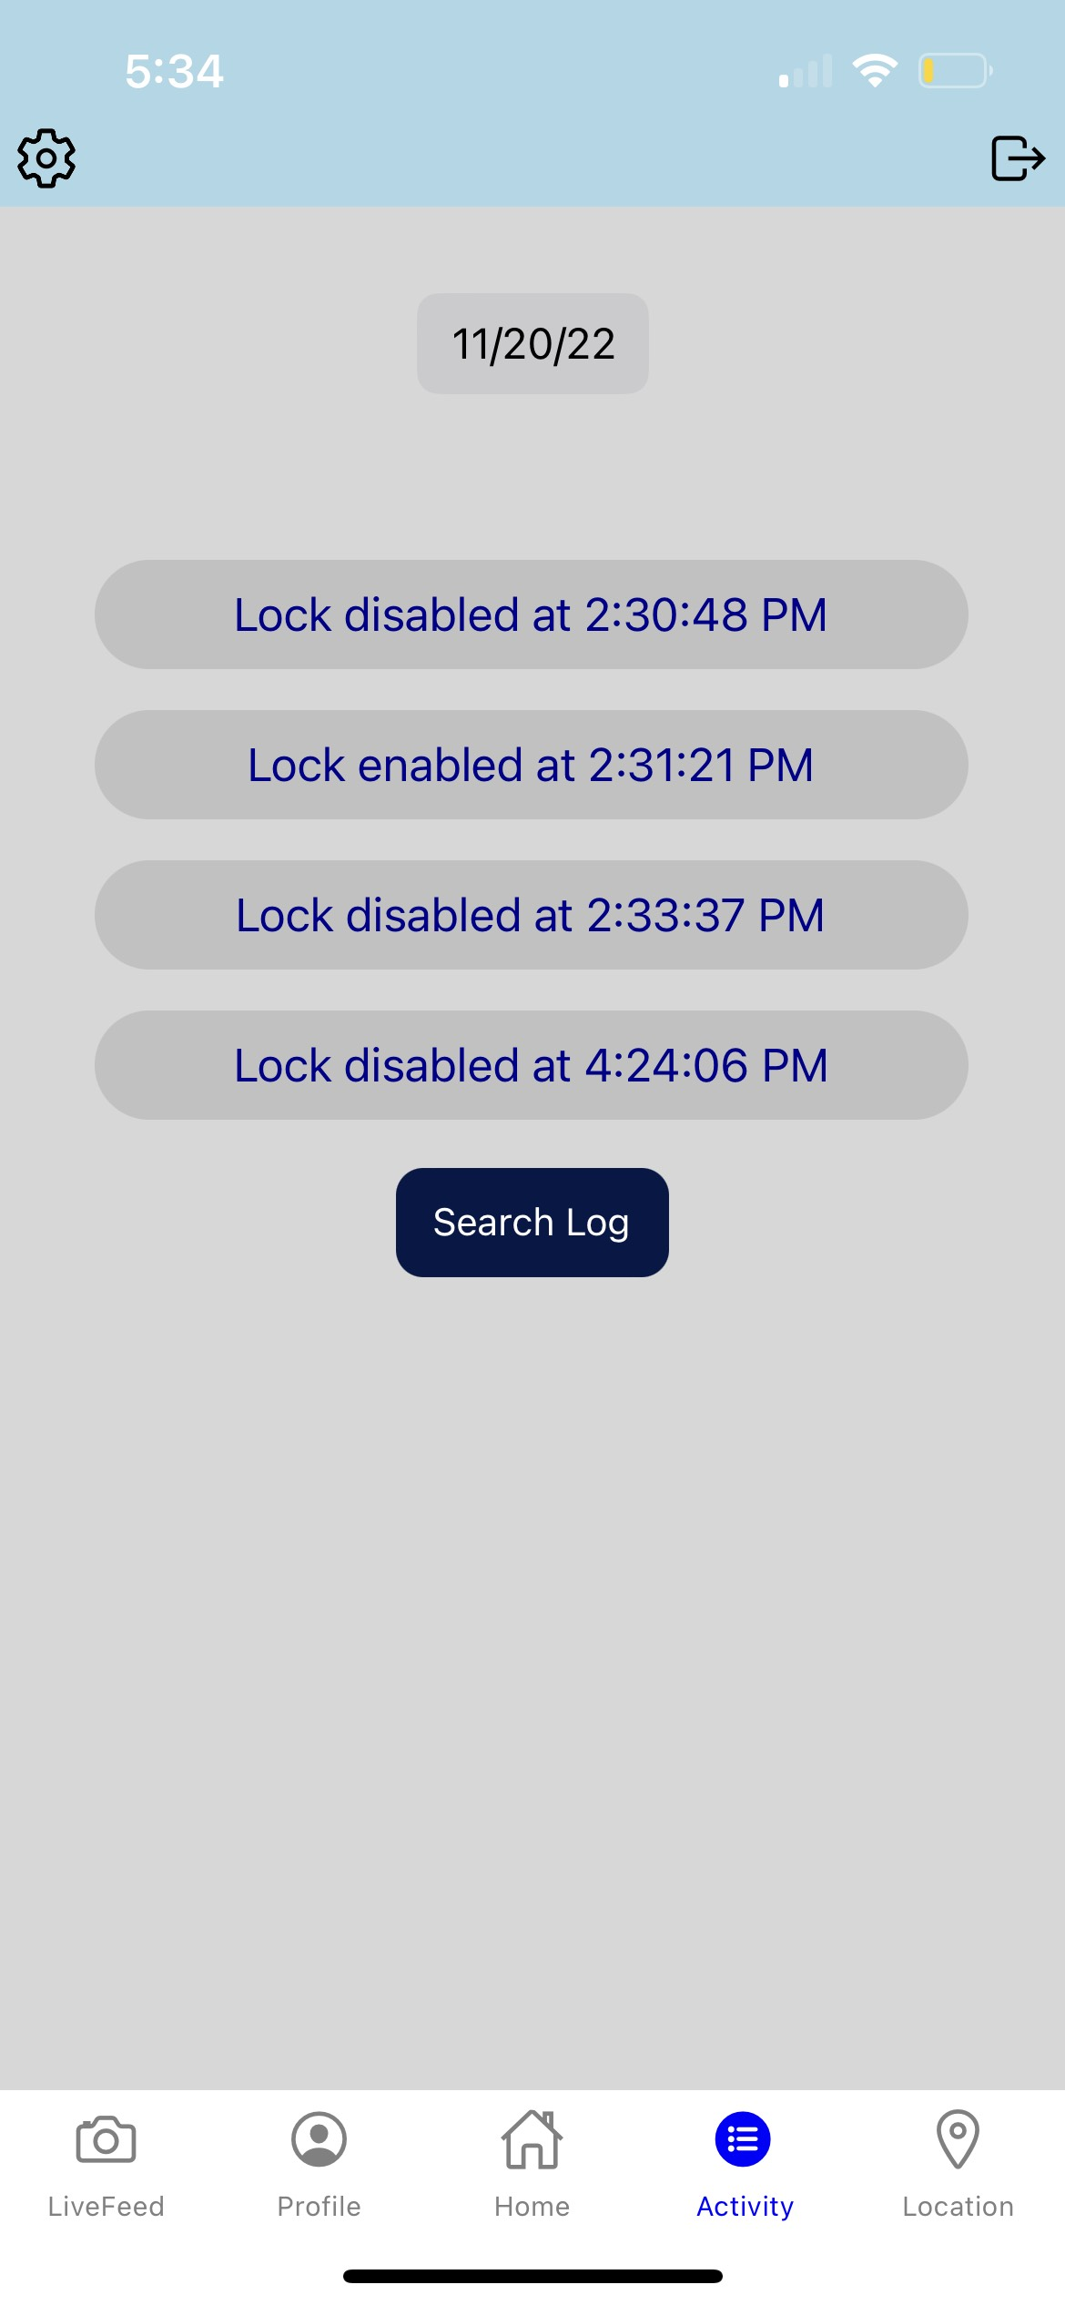
Activity Log
Allows the user to track the current status of the Live Bolt lock with exact timestamps.

Slide 20
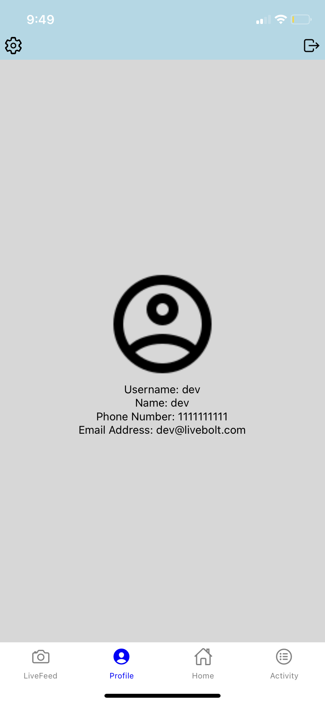
Profile/User Information
User information is loaded upon clicking the profile tab.
An API request is sent back to our Database to retrieve all the relevant user information.
The information made available to the user includes their Username, Full Name, Phone Number, and Email Address.

Slide 21
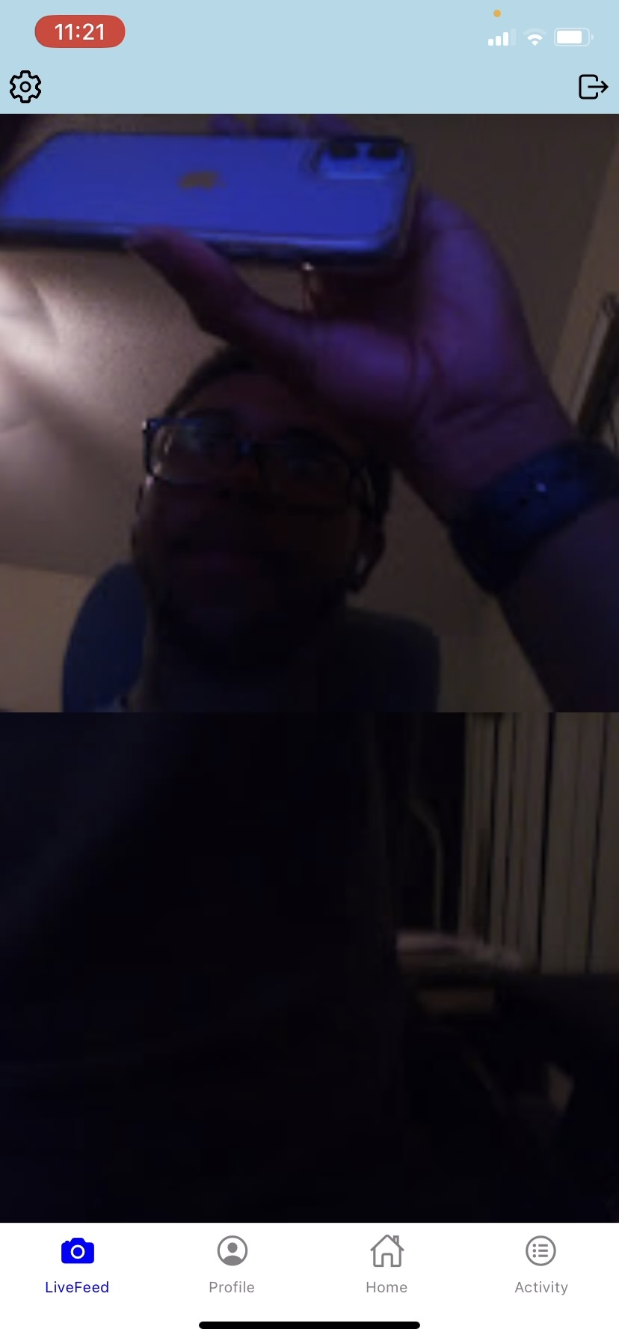
Camera Feed
Images are routinely made available to the user in the Mobile Application.
When motion is detected by the PIR sensor the camera for the security box snaps an image which sends that image to the mobile Application.
This is achieved through the Pi inside of the Security box which captures the image through its camera module and sends the image via an API for the mobile Application to access.

Slide 22
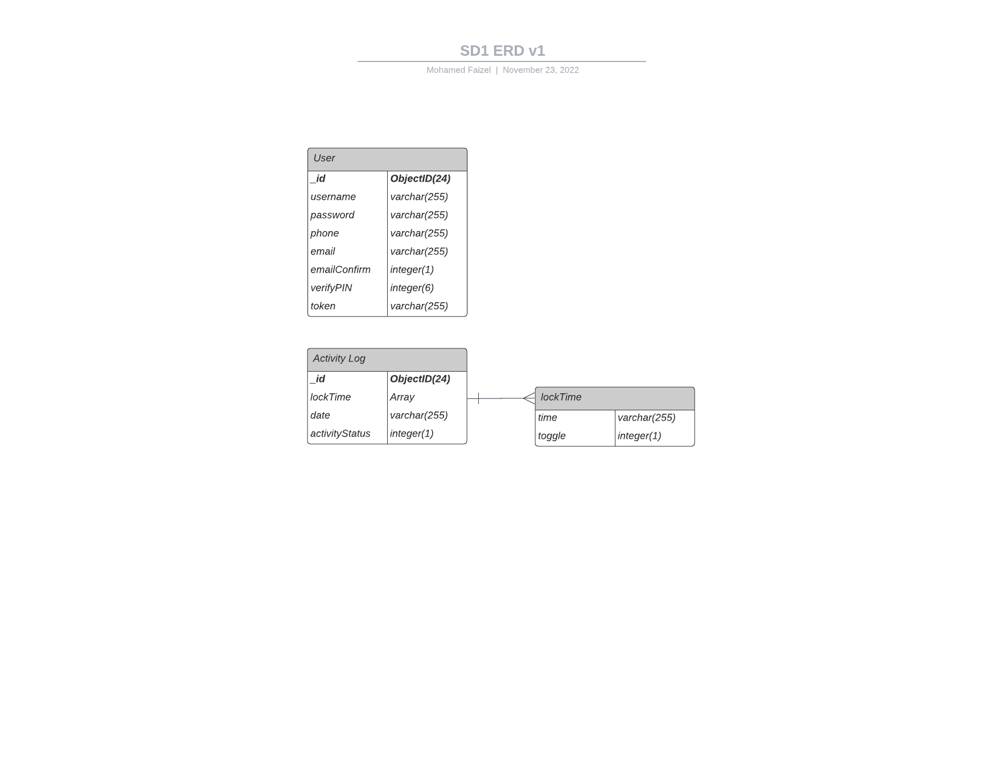
Database
The database mainly consists of three tables: Users, ActivityLog, and LiveFeed.
Each user object contains a unique key, while an activity log object consists of an array of timestamps detailing when the lock was enabled and disabled.

Slide 23

Fingerprint Authentication/Unlock
We will be using native touch recognition technologies on both Android and IOS devices. This includes TouchID on iPhones and Fingerprint Authentication on Android through the “expo-local-authentication” npm Package.
This Authentication methods can be used as alternative unlock and lock methods for the lock.
We hope that by using native mobile touch recognition technology users will have a better user experience then if it was integrated into the physical hardware itself.
Notes:
Joel – Needs to update

Slide 24

Selection of Parts
Notes:
Andrew

Slide 25
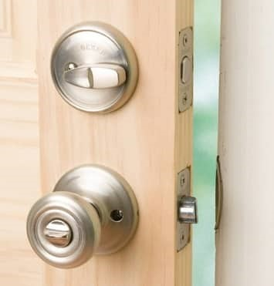
Deadbolt Lock
Seen in most homes
User manually turns thumb knob to strike deadbolt into place
Servo motor will be used to automate this process
Notes:
A traditional dead bolt lock is what is seen in most homes. It operates by having the user manually turn a thumb knob located on the inside of the home. When this knob is turned, the bolt is struck into place, blocking the door from being opened.
To automate this task for the purpose of the Live Bolt system, we will have a servo motor turn the bolt to allow the door to be locked or unlocked remotely without the need for a key or someone on the inside to unlock it.

Slide 26
MCU
A mix of 2 computing modules for various tasks:
Raspberry Pi 4B
ESP-12F
Notes:
Andrew

Slide 27
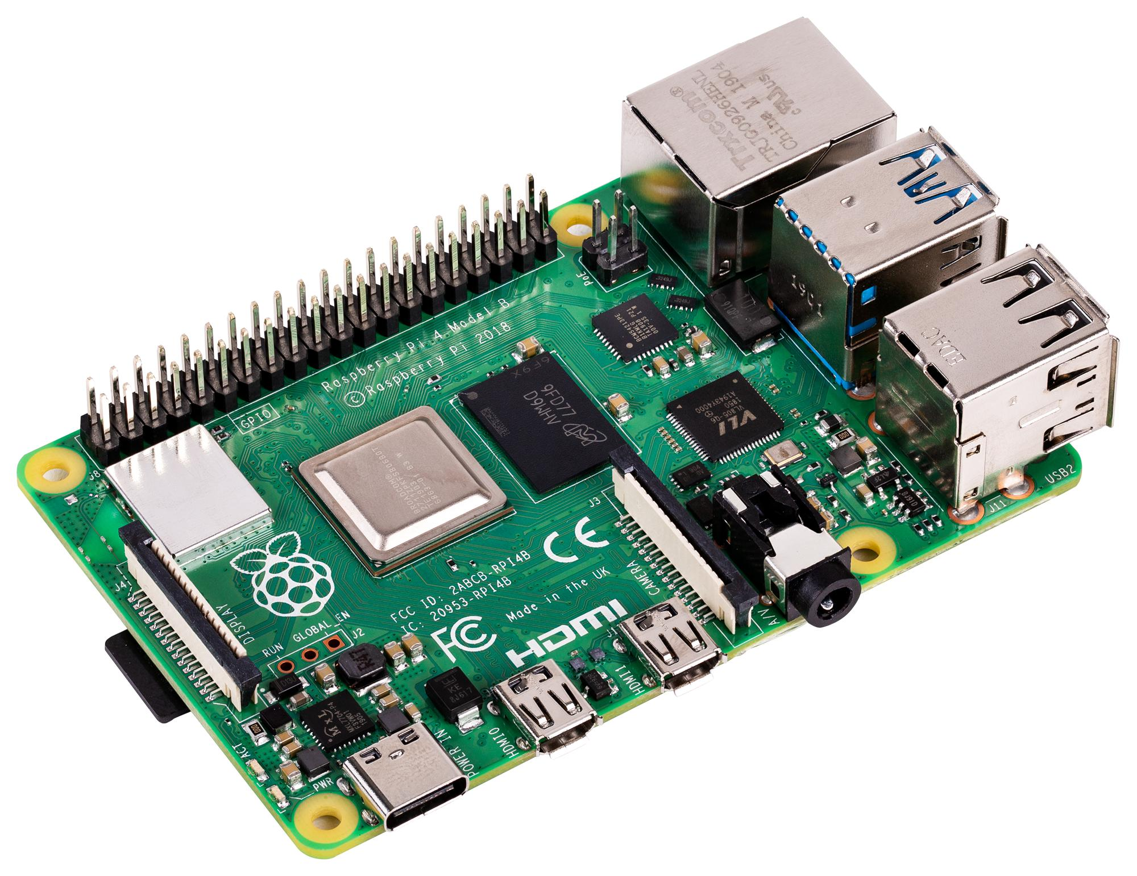
MCU – Raspberry Pi 4B
Connects hardware and software (app)
Handles connection between photo/PIR system and servo motor
Notes:
So first we have the Raspberry Pi 4 that connect the hardware with the software, or the phone application. So the raspberry pi will be responsible for telling the ESP servo when the lock or unlock button has been pressed in the app by the user. The Raspberry Pi will also the incoming photo feed from the camera and PIR sensor.

Slide 28
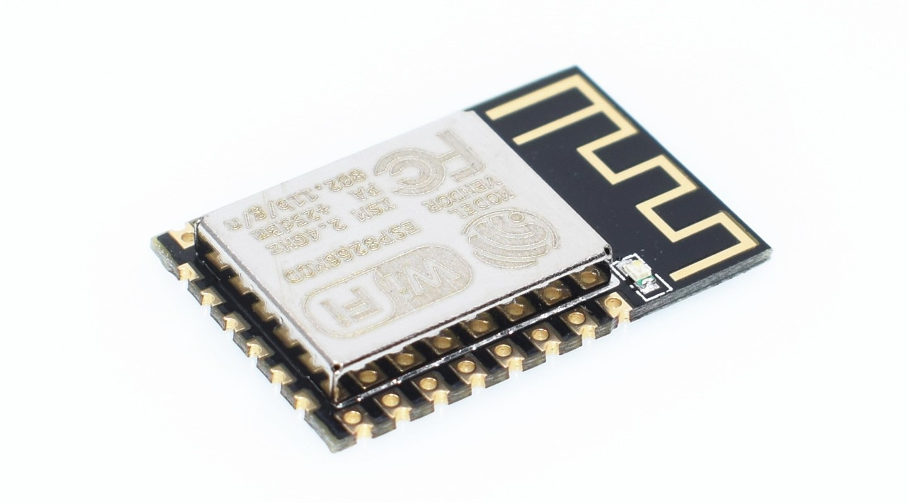
MCU – ESP-12F
Part of the ESP8266 development board
Connects security module (outside) to lock module (inside)
Security module sends signal to lock module to turn servo motor and unlock deadbolt
Notes:
Next we have the ESP-12F chip which is part of the ESP8266 development board. This chip will be used in each of our PCBs for the security module, located on the outside of thedoor, and the locking module, located inside of the door. The security ESP will process the keypad input and LED flashing to alert the user if the code was correct or incorrect. The locking ESP will communicate with both the security ESP and Raspberry Pi to know when to trigger the servo motor to lock/unlock the door.. We went with this chip because it has wifi capabilities that wil allow for communication between the indoor and outdoor modules wirelessly.

Slide 29
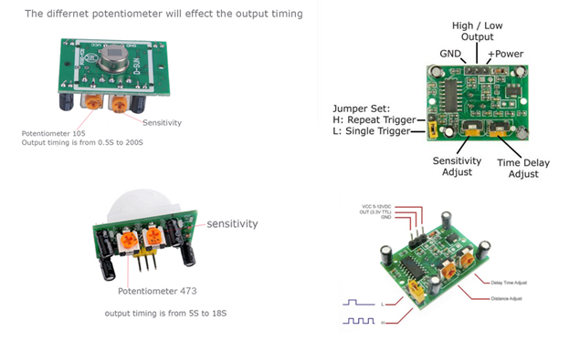
PIR Sensor
The PIR motion sensor will be part of the Security portion of the design to detect property activity.
The sensor is known for being energy efficient, high quality, and provide a long service life. There are sensitivity adjustments of 3 – 7 meters and time delay ranging from 3 seconds to 5 minutes.
Notes:
Linda
The PIR sensor will be integrated into the Raspberry Pi and will be a part of the security portion of the design to detect property activity. This PIR sensor is known for being energy efficient, high quality, and providing high service life. We programmed our PIR sensor to detect motion within 3 seconds. If there is motion, then it will trigger the pi camera to capture an image and send it to a google drive.

Slide 30
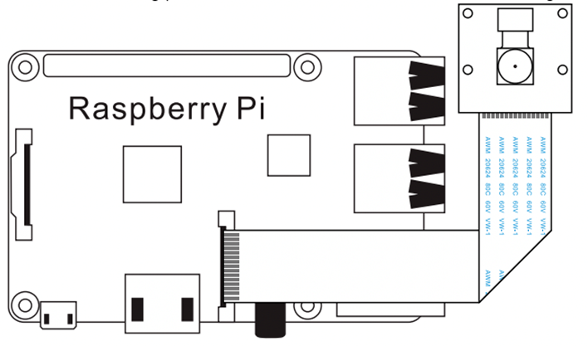
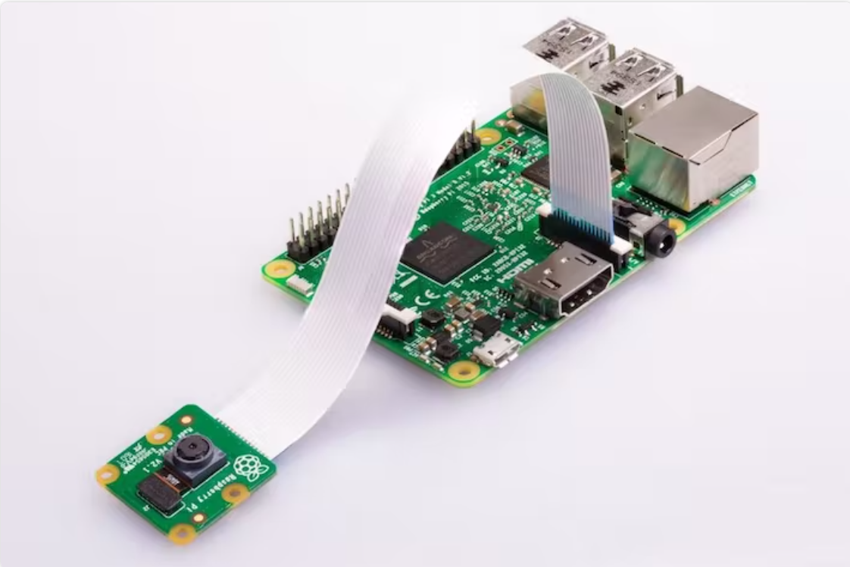
Raspberry Pi Camera
The Raspberry Pi camera module's objective will be to monitor the property and relay an image to a google drive via raspberry pi.
Implementing the camera would be provided in the security box and connected to the raspberry pi on board.
Notes:
Lind
We chose to use a raspberry pi camera for home monitoring to display property activity to the Live Bolt application. This hardware will be connected to the raspberry pi as shown in the image.

Slide 31
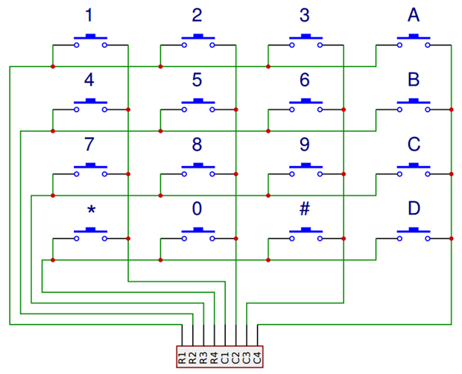
Arduino Keypad
The keypad's objective is designed to be a user's home entrance and one-time passcode for guests/ delivery service.
The idea is that the one-time passcode can be set through the hardware (front of the security box) and be sent back to the database
Notes:
Linda
The Arduino keypad will be used to a user’s home entrance and as a one-time passcode for guests/ delivery services. We plan on mounting the keypad to our security box and connecting it to our ESP-12F chip. The idea is that the one-time passcode can be set through the hardware (front of the security box) and be sent back to the database.

Slide 32
PCB and Schematic
Notes:
Andrew

Slide 33
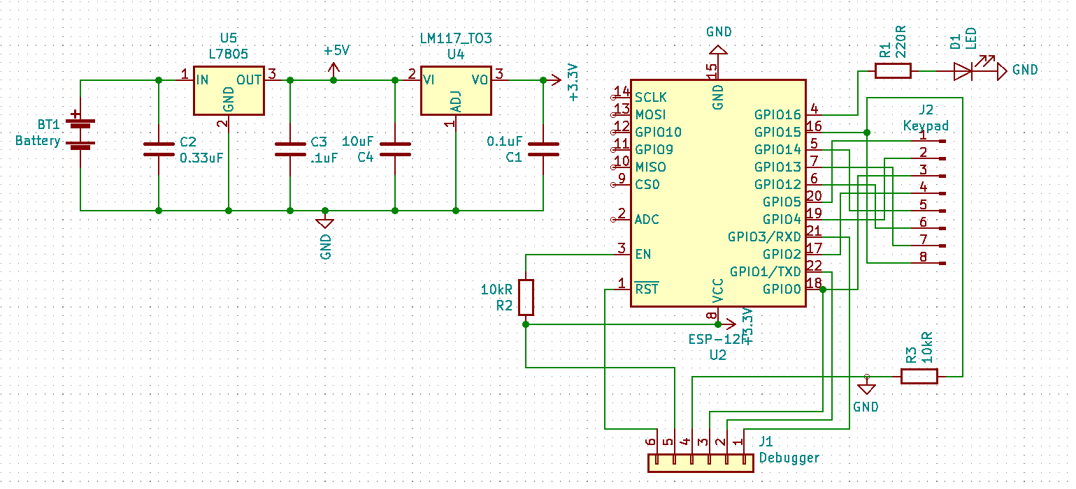
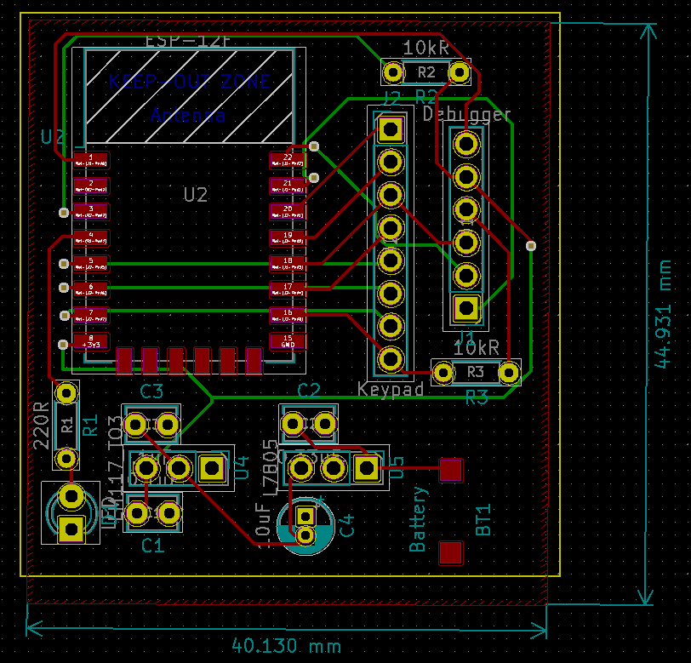
Security Circuit
Notes:
Here is the Security circuit that will be placed in the outdoor module.

Slide 34
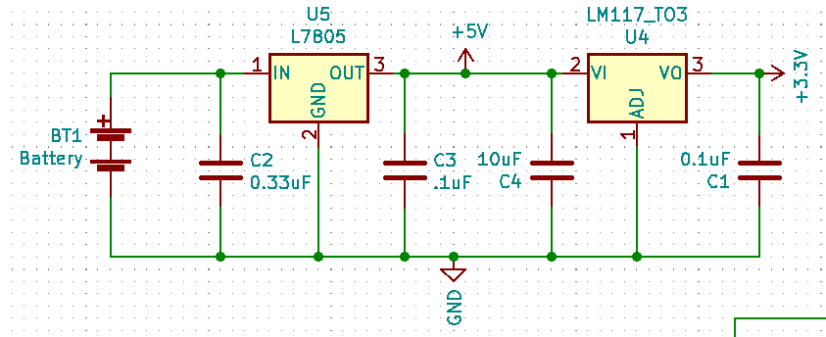
Security Circuit – Voltage Regulation
12V battery pack
L7805 5V linear voltage regulator
LM11733 3.3V linear voltage regulator
Replaced resistor voltage dividers
Notes:
Breaking up this schematic into multiple parts to view it easier, we first have the voltage regulation circuit. The 12V battery pack is stepped down to 5V using a L7805 voltage regulator, and then that is stepped down once more to 3.3V using a LM11733 voltage regulator. The 5V are then used to power the raspberry pi while the 3.3V are used to power the ESP-12F. Both regulators are linear and are using bypass capacitors with values found in each component’s data sheet. The voltage regulation circuit can be seen on the PCB to the right in the orange box. We originally had resistor-based voltage divider circuits in place of this regulator circuit but decided using linear regulators would be safer and more energy efficient since voltage dividers waste lots of energy through dissipated heat.

Slide 35
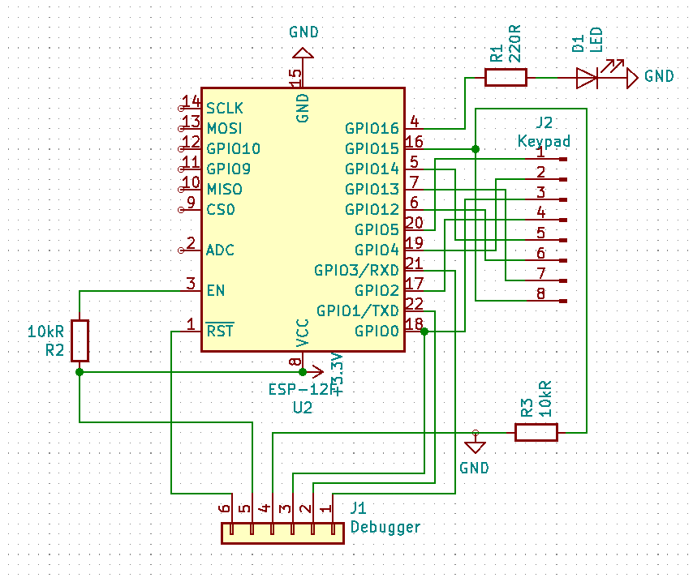
Security Circuit - Processor
ESP-12F, LED, Keypad, Debugger
ESP-12F and battery pack are SMT
Notes:
The other part of the security schematic is made up of the ESP-12F, the 8-pin keypad header, the feedback LED, and finally a 6-pin debugger header. This debugger header was added as a safety measure in case we needed to reprogram the ESP-12F chip after it was already desoldered from its development board. The feedback LED can be seen on the PCB in the yellow square. The debugger is within the white square, and the keypad header is just to the left of the debugger. Everything on this board besides for the ESP-12F and battery terminal are through-hole components. This is an unconventional choice as surface mount devices are preferred, but the team chose to go with through-hole technology to cut costs as our project is self-funded and we already had many of the Through-hole parts available to use free of cost.

Slide 36
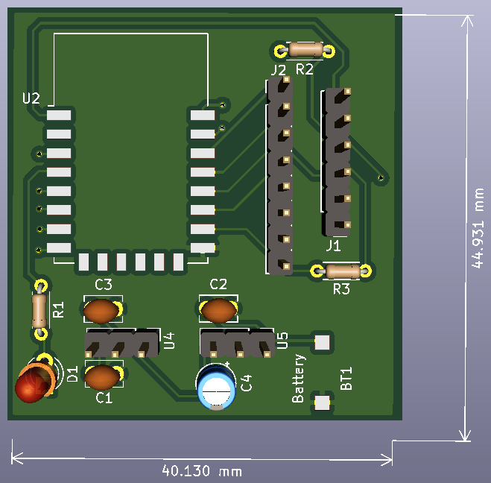
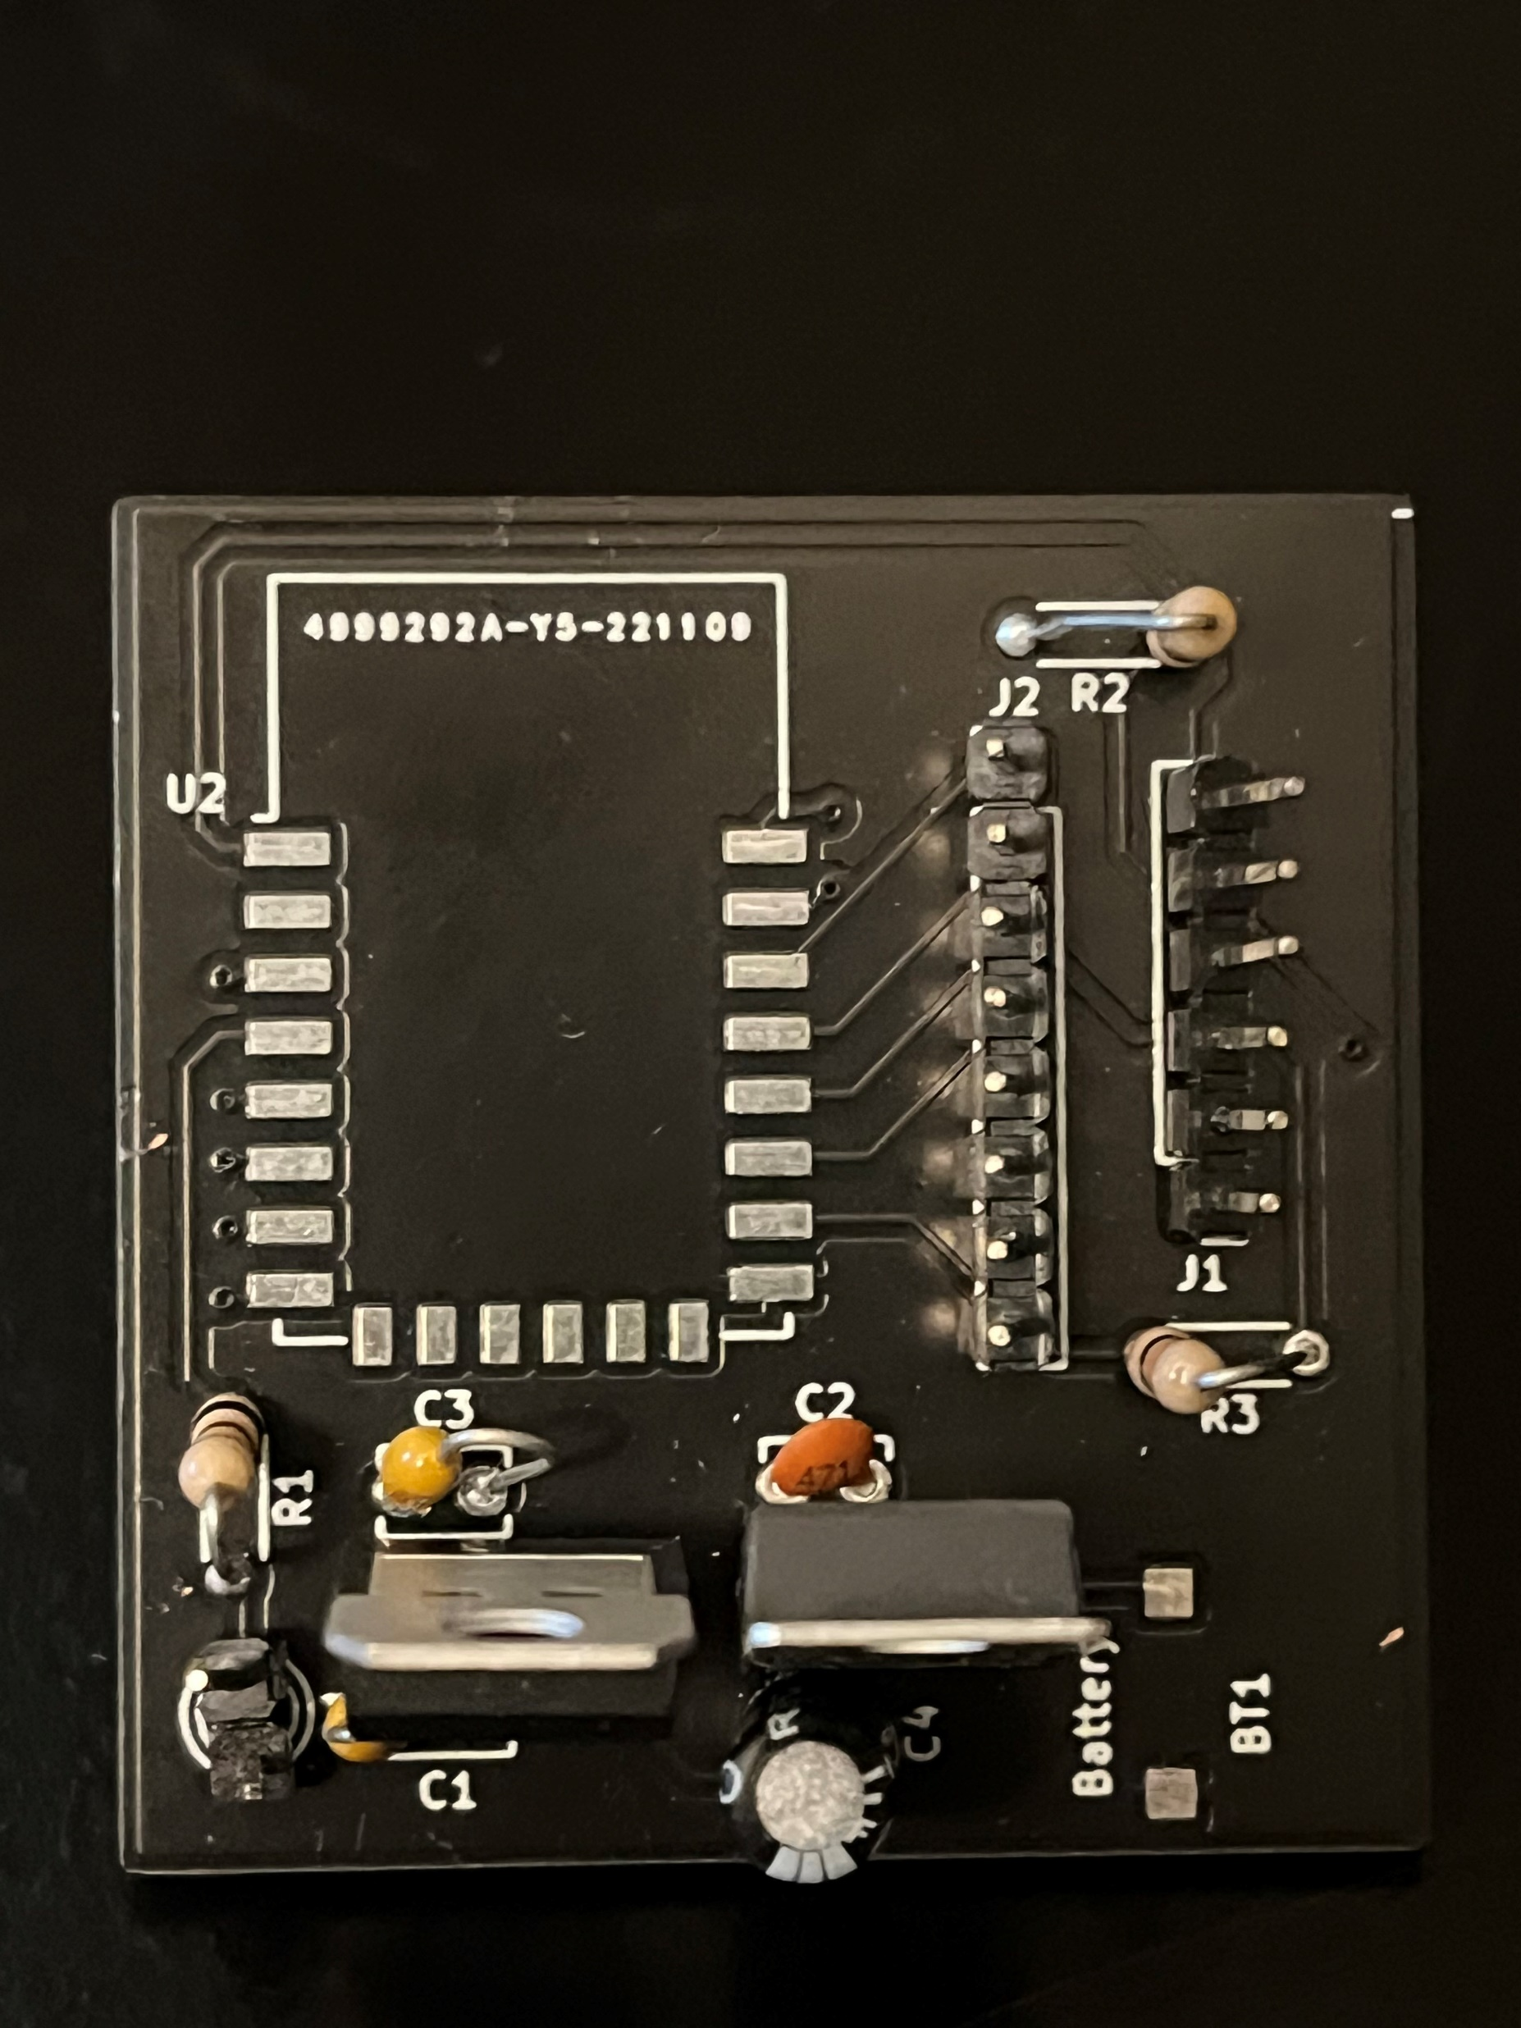
Security Circuit - PCB
Notes:
Here we can see the security circuit PCB rendered on the left and the actual print on the right. All the through hole components were soldered on for this image and the ESP-12F and battery terminals were soldered on before the final demonstration. The whole top of the board is a ground plane to help make routing traces easier and to suppress noise and allow the capacitors to filter the voltage regulators more effectively.

Slide 37
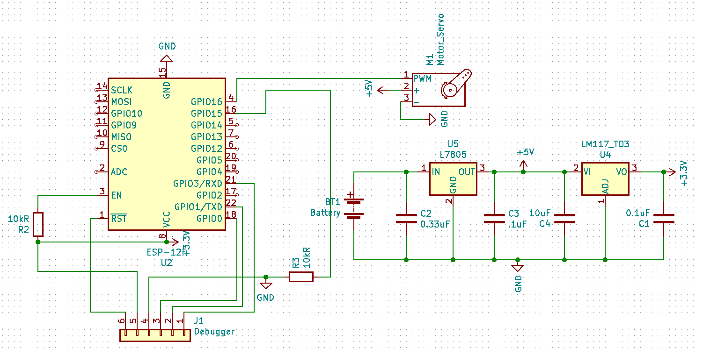
Lock Circuit - Schematic
5V powers servo motor
3.3V powers ESP-12F
Servo motor has a power pin, ground pin, and signal pin
Signal pin is driven by ESP-12F
Notes:
This is the lock schematic that is very similar to the security schematic, the main difference is that instead of the keypad and LED, this schematic has a servo that is driven by the ESP-12F GPIO pins and powered by the output of the 5V regulator. The regulator circuit and debugger are both identical to the security schematic.

Slide 38
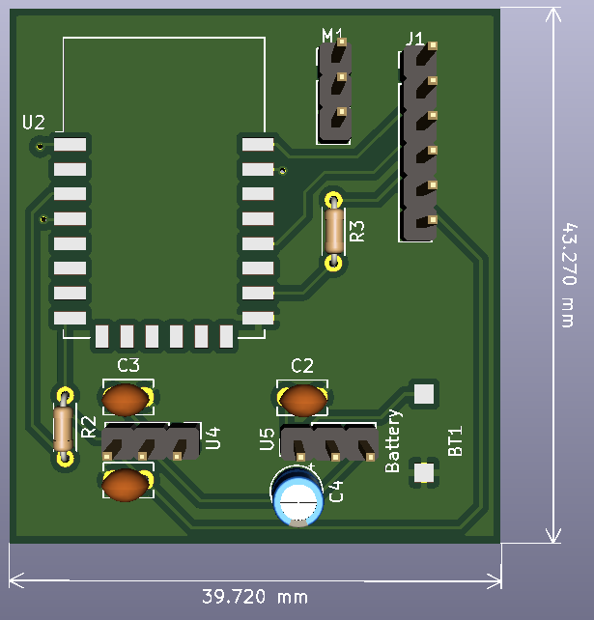
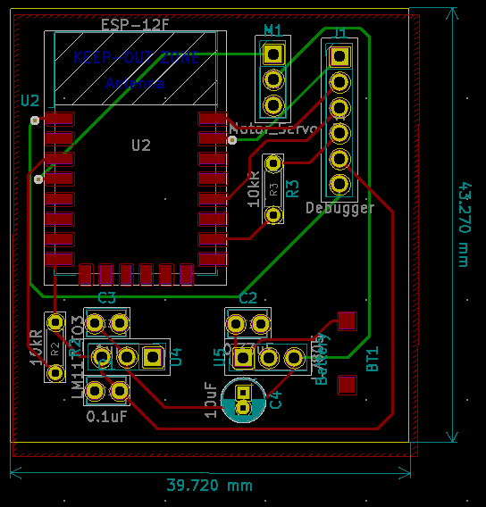
Lock Circuit - PCB
Notes:
The PCB is also very similar to the security PCB in both size and component placement. Note that the LED is no longer here, and the keypad headers have been replaced by a 3-pin header for the servo motor.

Slide 39
Housing and CAD Models

Slide 40
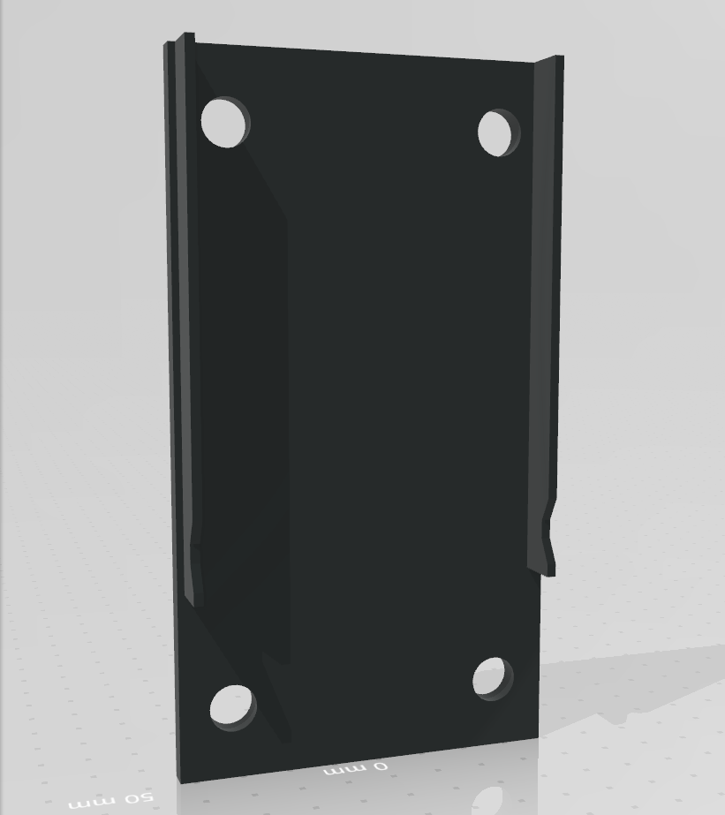
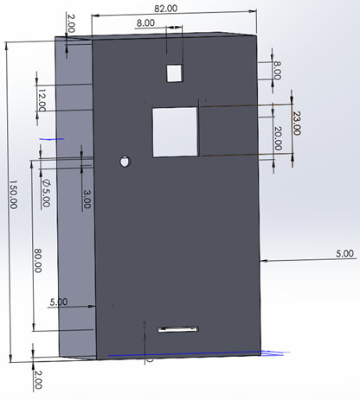
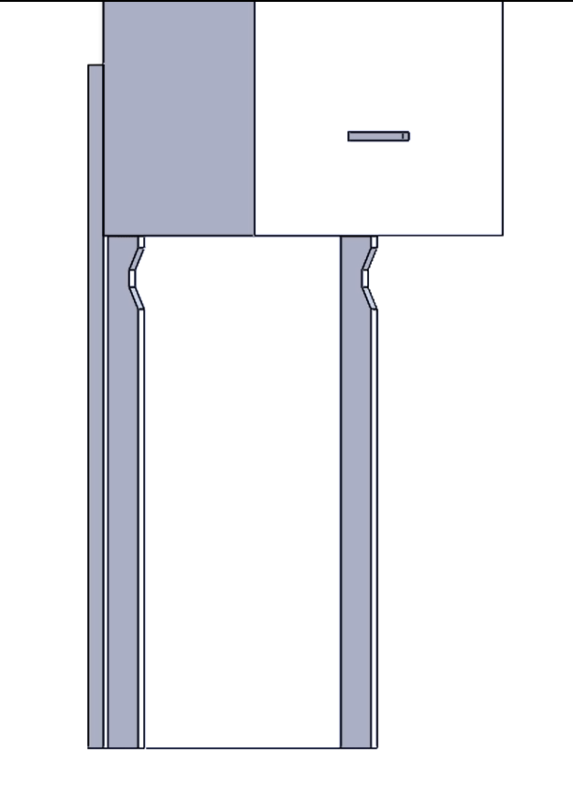
Security Box
Notes:
Linda
To house all the electronics, the team created a 3D model of boxes to perform that action. Beginning with the security box, the electronics that would need to be considered in size is the the PCB, PIR sensor, Arduino keypad, LED light, raspberry pi, and raspberry pi camera.
The features in our security box provides cuts/ openings to have these electronics in place or make their feature usable. Additionally, we've considered an open case box that can be accessible to a user. Mounting is possible with the back cover and screw holes to any users desired security location.

Slide 41
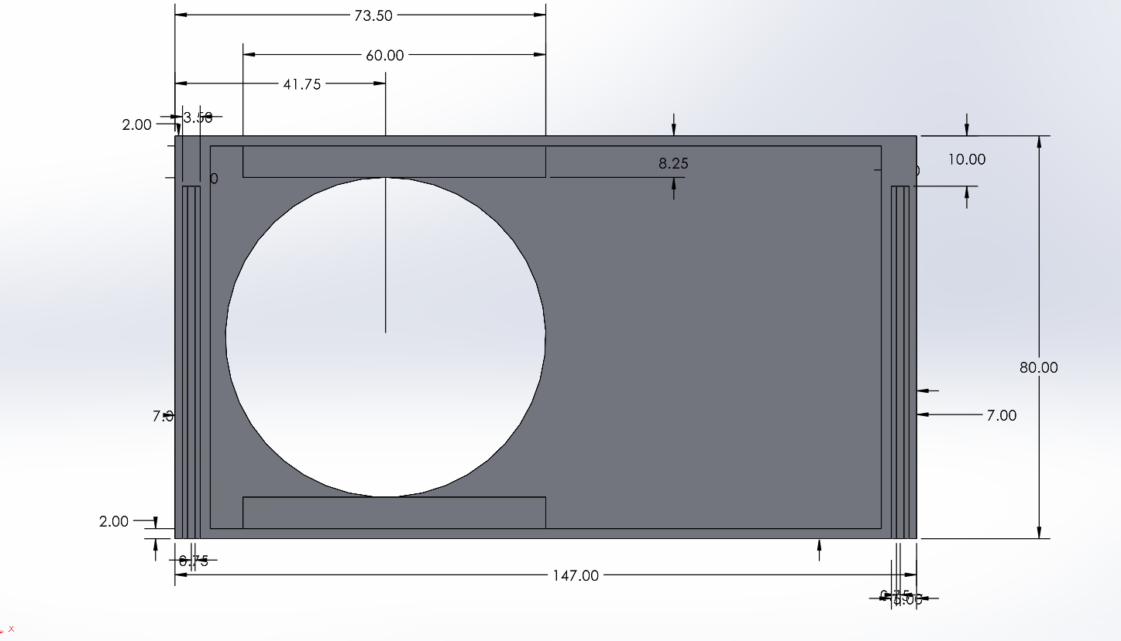
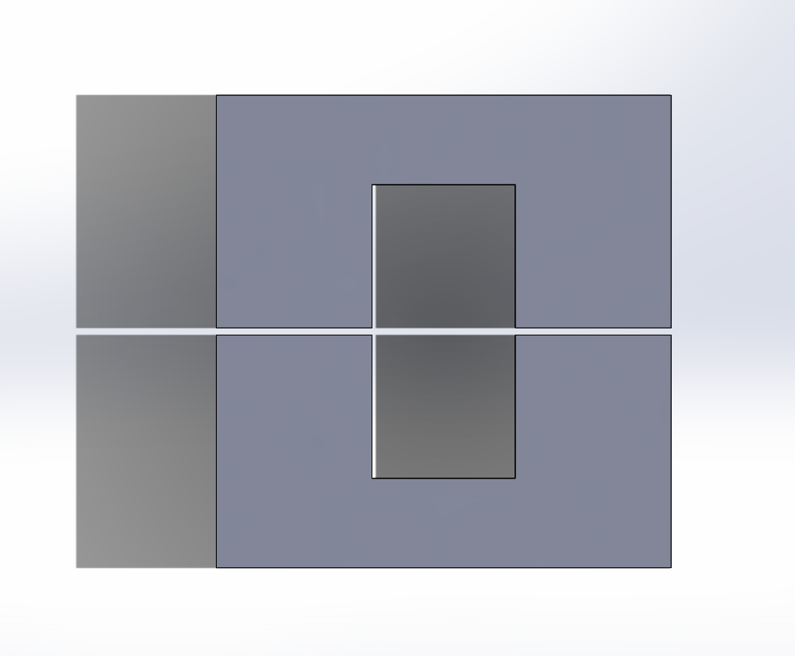
Lock Box
Notes:
Linda
Moving onto the lock box, this box will be installed inside the user's home on their deadbolt lock. This will also house the electronics such as the servo motor, ESP chip, and batteries. The space in the lockbox will account for the PCB size. The lockbox aspect will include a plate to hold the servo in place while turning the knob.

Slide 42
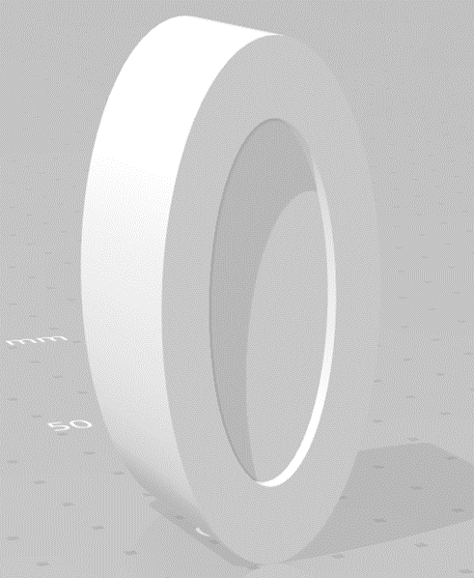
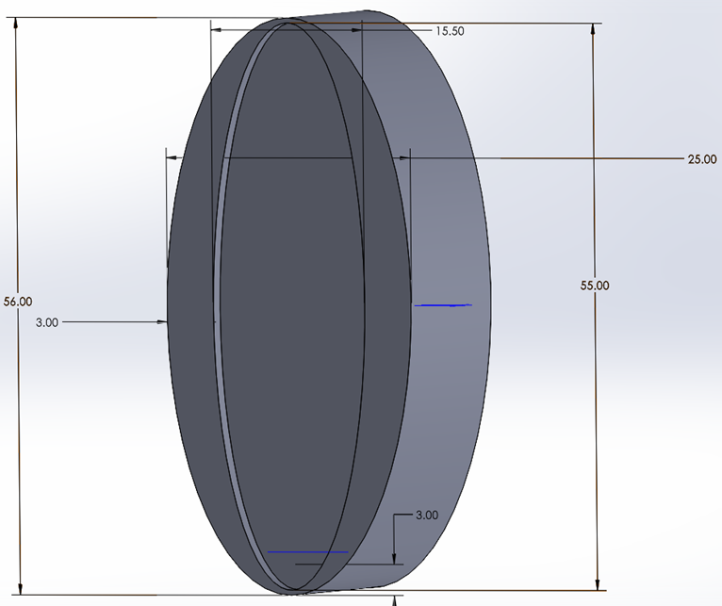
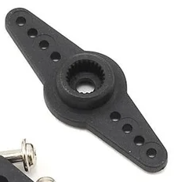
Knob Case Design
Notes:
Linda
To turn a deadbolt knob, we produced a knob case design to perform that action. When researching, we realized that not all deadbolt lock knobs came in one size. So, we decided to enlarge our knob design to fit standard deadbolt knobs. Our design concept revolved around using a straight horn that would attach to the servo.

Slide 43
Final Design

Slide 44
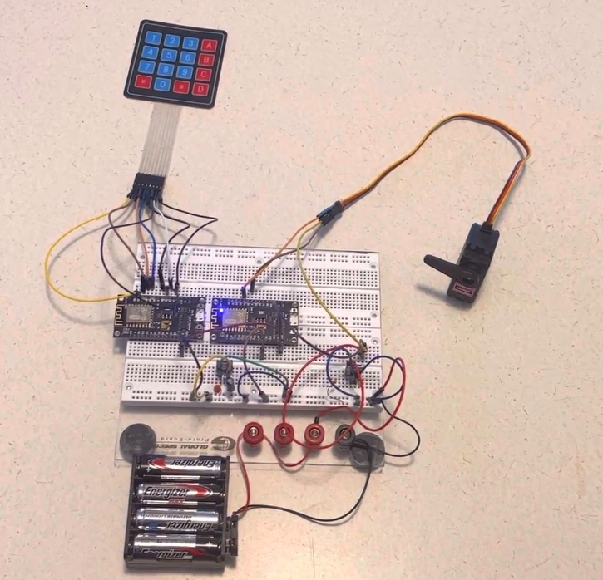
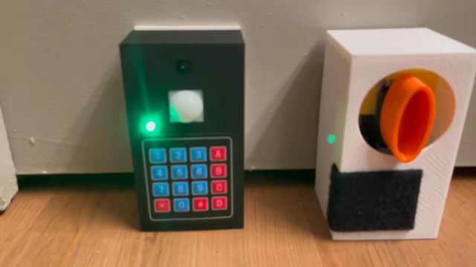
Final Design
Notes:
On the left is our prototype breadboard design used for the midterm demo and on the right are the finalized modules. The security module is the black one on the left with the keypad, LED, passive infrared sensor, and the Pi Camera. The white box on the right is the lock module with the orange knob holder that is turned by the servo motor. I’ll play a short demo now of how the lock would function given a correct code followed by the pound symbol, in this case, it is 1234.

Slide 45
Design Issues

Slide 46
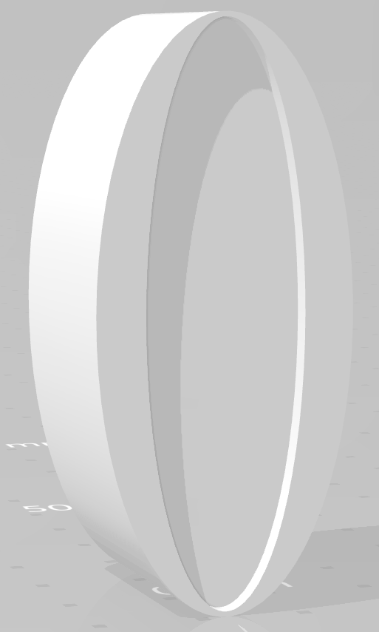
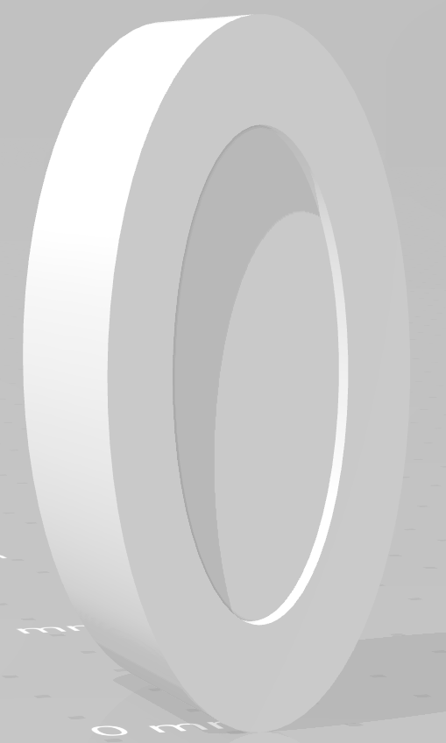
Hardware Design Issues
6V Battery Pack
NFC/ATmega328
2nd knob design
Resistor-based voltage dividers
1st knob cover design vs 2nd design
Notes:
We faced a variety of challenges during the Hardware design and testing phase. One major issue was that we found our original 6V battery pack could not consistently power the servo, and we needed to upgrade to the 12V packs we had on hand. The Servo was experiencing jittering and clicking behaviors that are signs of low power. Another Issue was that we wanted to include NFC, but due to incompatible drivers with the ESP, we tried to also include an ATMega328 from an Arduino uno to include NFC. After a reassment of our priorities and features, we decided having 3 MCUs in the project was unnecessary and decided to get rid of the NFC feature.
Another issue we came across was with the 3D model of our knob design. The indentation for the servo horn to rest was too long and didn’t allow for the servo horn to fully turn the knob cover. This indentation was improved in the second iteration and the servo horn fit.
Lastly, as previously mentioned, we originally had chosen resistor-based voltage dividers to step down our voltages to 5v and 3.3v, but eventually opted for linear voltages regulators with capacitors to achieve the same result.

Slide 47
Software Design Issues
Scope of the Mobile Application
Communication between the Mobile Application and the Servo Motor using MQTT
Communication between the Mobile Application and Heroku Backend

Slide 48
Standards and Design Constraints
Notes:
Now we’ll go over engineering standards used in this project and design constraints we had to keep in mind throughout development.

Slide 49
Standards
Standard | Explanation
Wi-Fi (IEEE 802.11) | We will be using a Raspberry Pi in our system which uses the 802.11ac standard or Wi-Fi 5. This standard supports simultaneous connections on both 5 GHz and 2.4 GHz Wi-Fi devices.
Measurement (SI) | Our design will keep in the international System of Units (SI) and use millimeters (mm) when obtaining dimensions.
Deadbolt (ANSI) | ANSI Grading System was formed by the Builders Hardware Manufacturers Association (BHMA. Grade 2 locks are used on many residential houses.
Battery (IEC 60086) | AA batteries are standardized by the International Electrotechnical Commission (IEC) 60086 code.
PCB (IPC-2221) | The Institute of Printed Circuits maintains the standards for PCB design. We can use some of the standards within IPC-2221, like component mounting and multilayer rules.
Notes:
This is a table of related standards that impacted the design of the Live-Bolt system, such as the IPC-2221 PCB standard and the ANSI Grade 2 standard for the residential deadbolt lock we are designing for.

Slide 50
Constraints
Constraint
Knowledge
Economic
Time
Environmental
Energy
Social
Political
Ethical
Health and Safety
Sustainability
Manufacturability
Notes:
Here are some of the constraints we had to consider when designing this project. The time and economic constraints were some of the more prominent ones as we are on a deadline to finish the project and it is fully self-funded. A full explanation of the constraints is included in our senior design paper.

Slide 51
Administrative Content

Slide 52
Division of Tasks
 | Andrew | Linda | Joel | Mohamed
Frontend |  |  | X | X
Backend |  |  |  | X
API |  |  | X | X
PCB | X
MCU Programming | X | X
CAD |  | X | X
Notes:
Mohamed

Slide 53

Budget and Financing
Part Description | Qty Needed | Actual Price/Unit | Estimated Price/Unit | Actual Total Price | Estimated Total Price
Raspberry Pi 4B | 1 | $0 | $35 | $0 | $35
Assorted Wires, LED, and other components | - | $0 | $17 | $0 | $17
Camera | 2 | $15 | $15 | $30 | $15
Keypad | 2 | $0 | $9 | $0 | $9
PIR Motion Sensor | 2 | $8 | $8 | $16 | $16
High Torque Servo | 1 | $20 | $20 | $20 | $20
Servo Horns | 1 | $8 | $8 | $8 | $8
12V Battery pack holder | 1 | $7 | $7 | $7 | $7
PETG 3D Filament | 1 | $6 | $6 | $6 | $6
Velcro | 1 | $8 | $8 | $8 | $8
ESP8266 | 1 | $0 | $18 | $0 | $18
PCB Printing | 2 | $2 | $2 | $4 | $4
Total Members | 4 | $34 | $53.75 | $136 | $215

